Slide 1

CME538 Introduction to Data Science
Week 2 | Lecture 1 (2.1)
Pandas I.

Slide 2

Pandas I
What is Pandas?

Slide 3
Pandas I
What is Pandas?
These are Pandas.

Slide 4
Pandas I
What else is Pandas?
A fast, powerful, flexible and easy to use open-source data analysis and manipulation tool, built on top of the Python programming language.
Pandas stands for “Python Data Analysis Library ”.

Slide 5
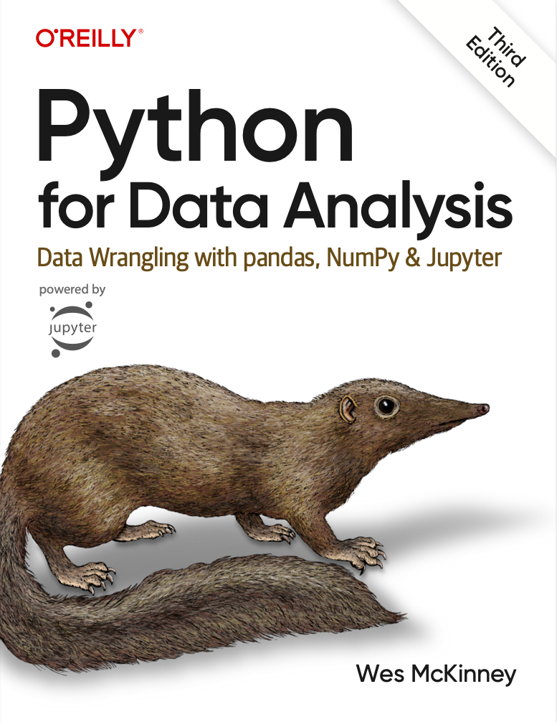
Pandas I
You have free access to a fantastic book by the creator of Pandas!
Click here.

Slide 6
Pandas I
DataFrames
Pandas Data Structures
Importing Data
Indexing
Utility Methods

Slide 7
Pandas I
DataFrames
Pandas Data Structures
Importing Data
Indexing
Utility Methods

Slide 8
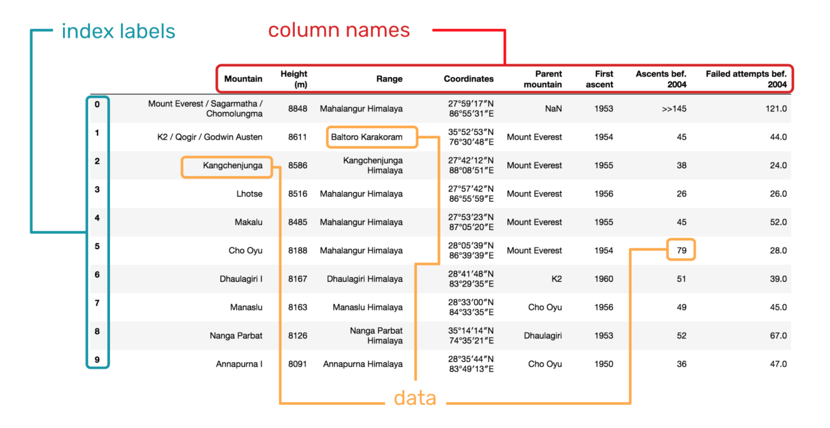
DataFrames
A DataFrame is a 2-dimensional labeled data structure with columns of potentially different types.
Matrix?
You can think of it like a spreadsheet or SQL table.
DataFrames were first introduced in the R Programming Language and are generally the most used Pandas object.
Pandas is the most popular Python package for working with DataFrames.
Dask, Polar, Vaex.

Slide 9
Pandas I
DataFrames
Pandas Data Structures
Importing Data
Indexing
Utility Methods

Slide 10
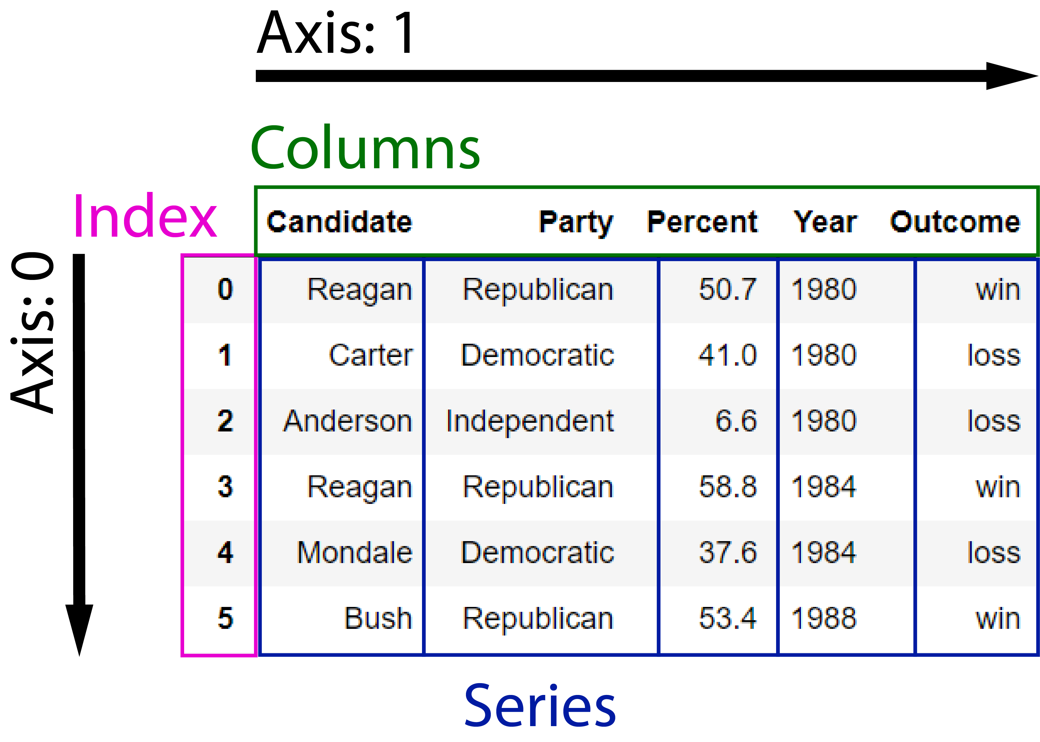
Data Structures
Dataset
U.S. Election Results.
There are three fundamental data structures in pandas:
Data Frame: 2D data tabular data.
Series: 1D data. We can think of Series as columnar data.
Index: A sequence of row labels.

Slide 11
Data Structures
DataFrames
There are three fundamental data structures in pandas:
Data Frame: 2D data tabular data.
Series: 1D data. We can think of Series as columnar data.
Index: A sequence of row labels.

Slide 12
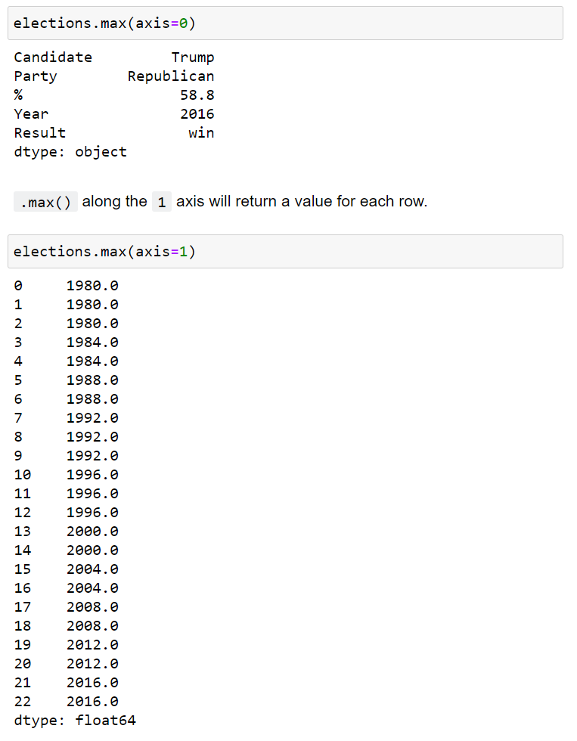
Data Structures
Axis 0
Column-wise
There are three fundamental data structures in pandas:
Data Frame: 2D data tabular data.
Series: 1D data. We can think of Series as columnar data.
Index: A sequence of row labels.
Axis 1
Row-wise

Slide 13
Data Structures
Series
We can think of a Data Frame as a collection of Series that all share the same Index.
There are three fundamental data structures in pandas:
Data Frame: 2D data tabular data.
Series: 1D data. We can think of Series as columnar data.
Index: A sequence of row labels.
Candidate
Series
Party
Series
Percent
Series
Outcome
Series
Year
Series

Slide 14
Data Structures
Series
We can think of a Data Frame as a collection of Series that all share the same Index.
There are three fundamental data structures in pandas:
Data Frame: 2D data tabular data.
Series: 1D data. We can think of Series as columnar data.
Index: A sequence of row labels.
Candidate
Series

Slide 15
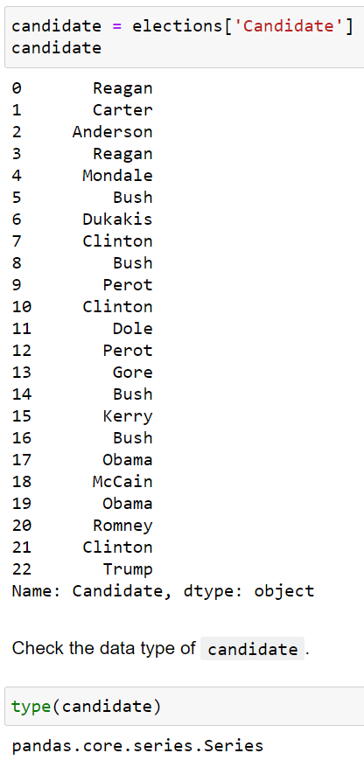
Data Structures
There are three fundamental data structures in pandas:
Data Frame: 2D data tabular data.
Series: 1D data. We can think of Series as columnar data.
Index: A sequence of row labels.

Slide 16
Data Structures
Index
There are three fundamental data structures in pandas:
Data Frame: 2D data tabular data.
Series: 1D data. We can think of Series as columnar data.
Index: A sequence of row labels.
Index

Slide 17
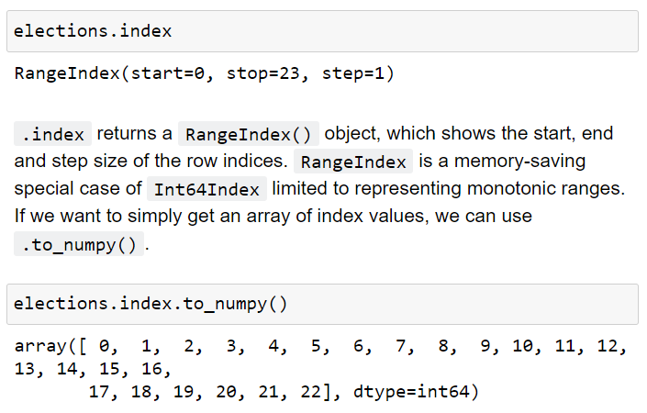
Data Structures
There are three fundamental data structures in pandas:
Data Frame: 2D data tabular data.
Series: 1D data. We can think of Series as columnar data.
Index: A sequence of row labels.

Slide 18
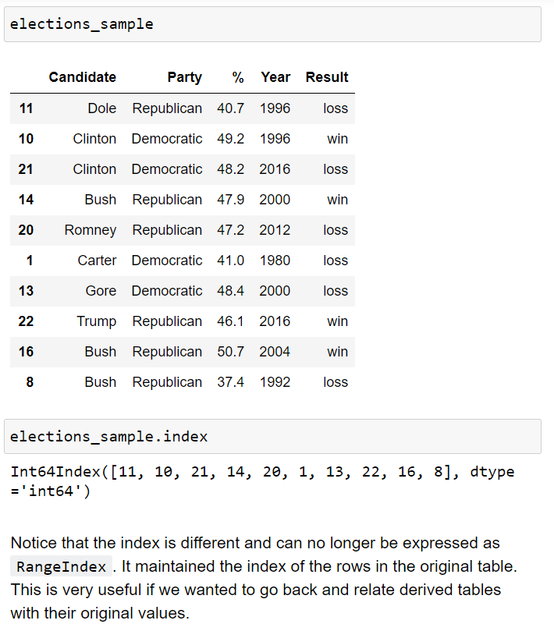
Data Structures
There are three fundamental data structures in pandas:
Data Frame: 2D data tabular data.
Series: 1D data. We can think of Series as columnar data.
Index: A sequence of row labels.

Slide 19
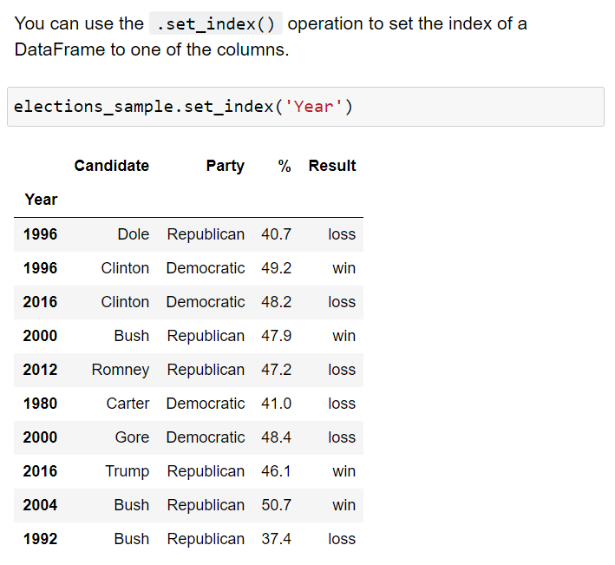
Data Structures
There are three fundamental data structures in pandas:
Data Frame: 2D data tabular data.
Series: 1D data. We can think of Series as columnar data.
Index: A sequence of row labels.
Indices (row labels) can also:
be non-numeric
have a name (e.g. “Year”).

Slide 20
Data Structures
There are three fundamental data structures in pandas:
Data Frame: 2D data tabular data.
Series: 1D data. We can think of Series as columnar data.
Index: A sequence of row labels.
Indices (row labels) do not have to be unique.

Slide 21
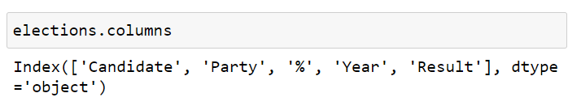
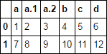
Data Structures
There are three fundamental data structures in pandas:
Data Frame: 2D data tabular data.
Series: 1D data. We can think of Series as columnar data.
Index: A sequence of row labels.
Columns (Series names).
Column names in Pandas are almost always unique!
You really shouldn’t have two columns named “Candidate”.

Slide 22
Pandas I
DataFrames
Pandas Data Structures
Importing Data
Indexing
Utility Methods

Slide 23
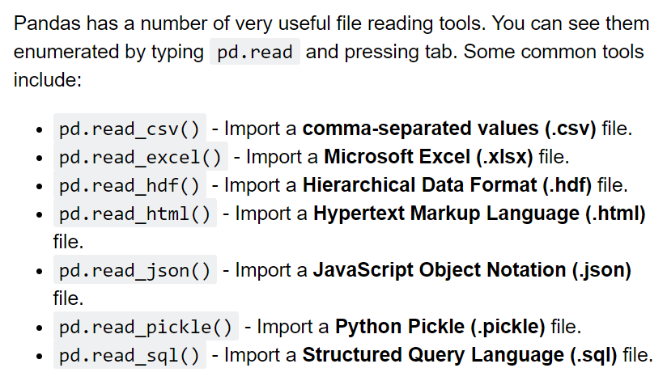
Importing Data
Pandas has a number of useful functions for importing data from common formats.

Slide 24
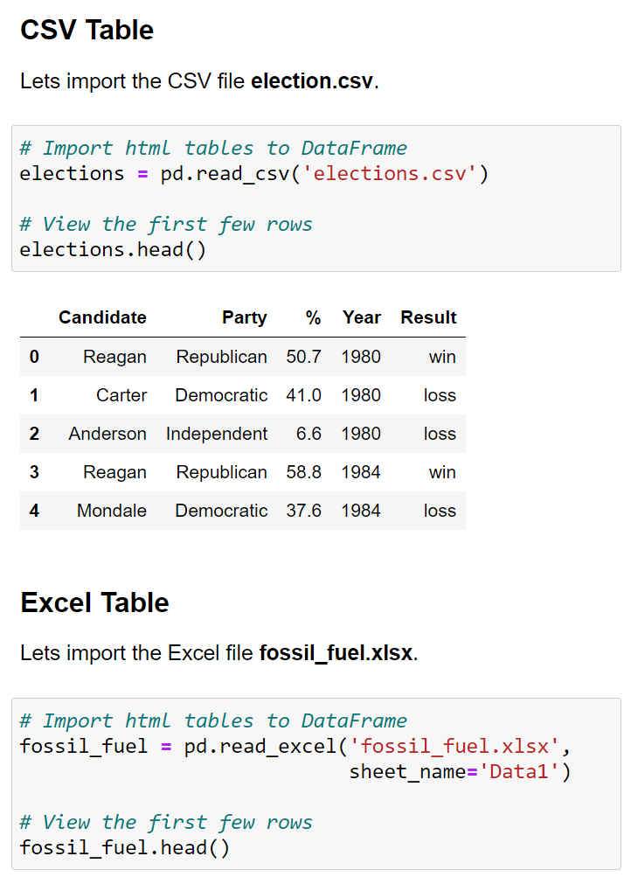
Importing Data
Pandas has a number of useful functions for importing data from common formats.
To get a quick look at the first 5 rows of a DataFrame, use the .head() method.

Slide 25
Pandas I
DataFrames
Pandas Data Structures
Importing Data
Indexing
Utility Methods

Slide 26
Indexing
There are many ways to access rows and columns of a Pandas DataFrame.
We will spend some time reviewing the most used options.
[]
.loc[]
Boolean Array Selection
.iloc[]

Slide 27
Indexing
There are many ways to access rows and columns of a Pandas DataFrame.
We will spend some time reviewing the most used options.
[]
.loc[]
Boolean Array Selection
.iloc[]

Slide 28
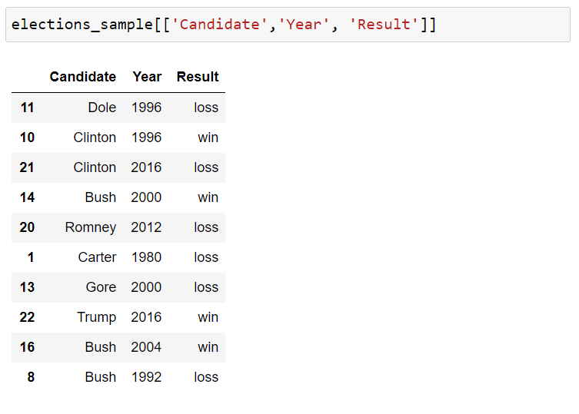
Indexing - [] Operator
You can access columns using the square [ ] brackets.
You can pass a list of column names to select only those columns.

Slide 29
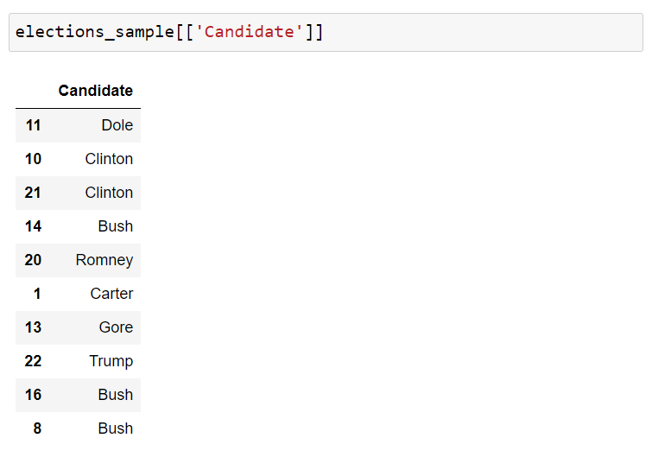
Indexing - [] Operator
You can access columns using the square [ ] brackets.
If you pass a list with a single element you get back a DataFrame.

Slide 30
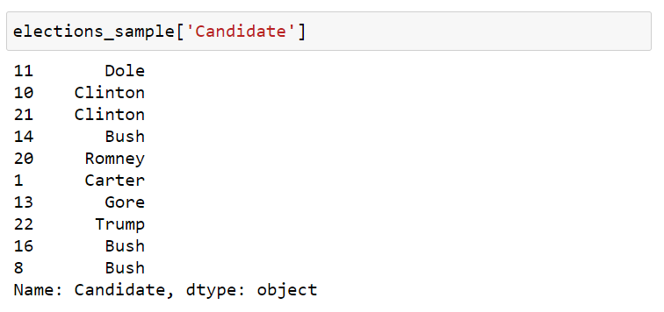
Indexing - [] Operator
You can access columns using the square [ ] brackets.
If you pass single column name string, you get back a Series.

Slide 31
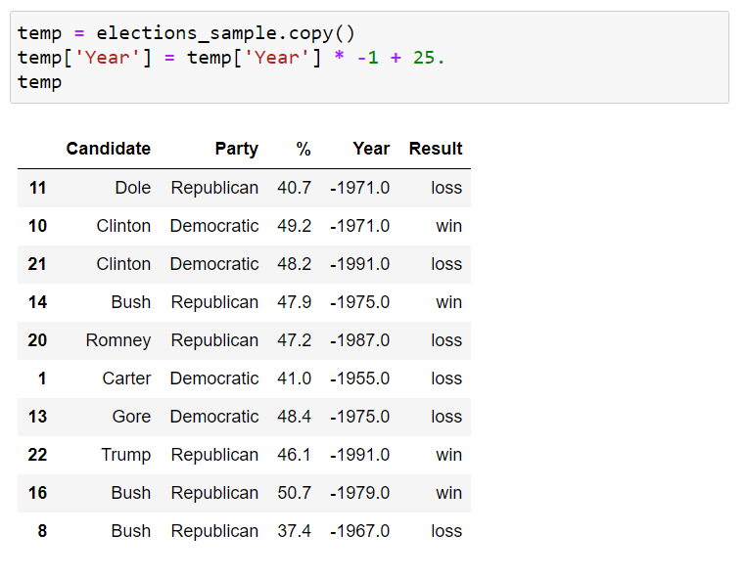
Indexing - [] Operator
You can access columns using the square [ ] brackets.
You can modify and even add columns using the square brackets [ ].

Slide 32
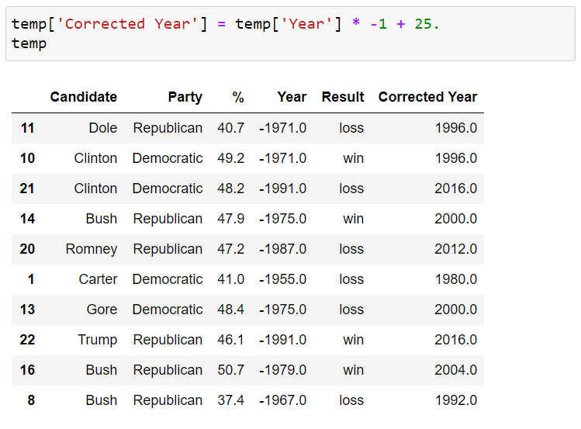
Indexing - [] Operator
You can access columns using the square [ ] brackets.
We can add a new column by assignment.

Slide 33
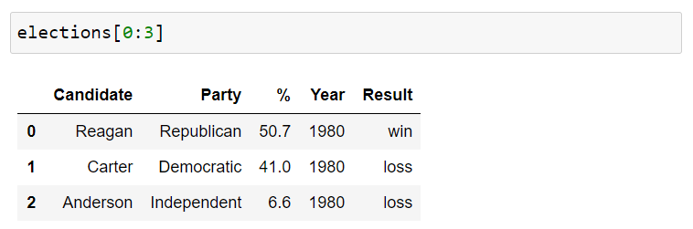
Indexing - [] Operator
You can access columns using the square [ ] brackets.
We can also index by row numbers using the [] operator.
This is called a numeric slice.

Slide 34
Indexing - [] Operator
You can access columns using the square [ ] brackets.
Note:
elections[0] will not work unless the elections DataFrame has a column whose name is the numeric zero.
It is possible for columns to have names that are non-String types, e.g. numeric, datetime etc.

Slide 35
Indexing
There are many ways to access rows and columns of a Pandas DataFrame.
We will spend some time reviewing the most used options.
[]
.loc[]
Boolean Array Selection
.iloc[]

Slide 36
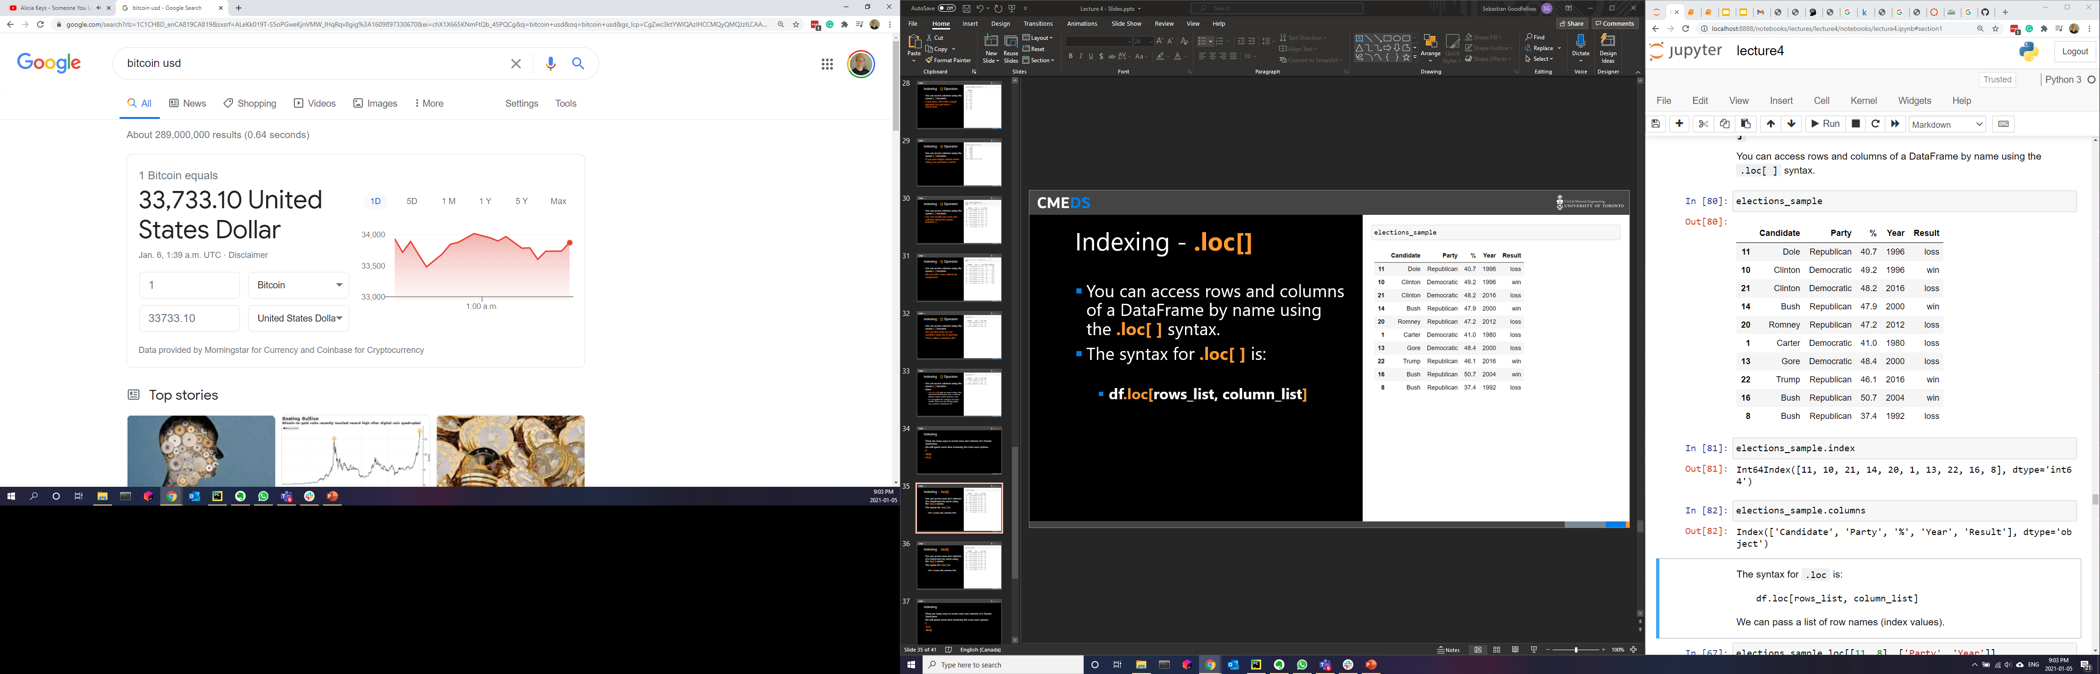
Indexing - .loc[]
You can access rows and columns of a DataFrame by name using the .loc[ ] syntax.
The syntax for .loc[ ] is:
df.loc[rows_list, column_list]

Slide 37
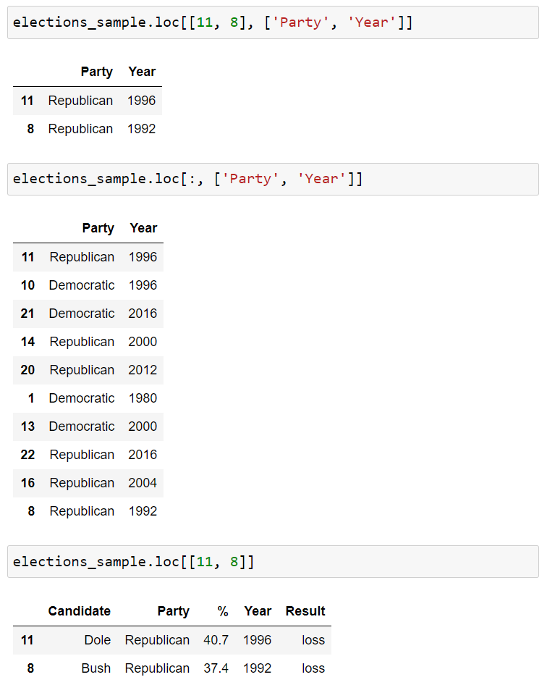
Indexing - .loc[]
You can access rows and columns of a DataFrame by name using the .loc[ ] syntax.
The syntax for .loc[ ] is:
df.loc[rows_list, column_list]

Slide 38
Indexing - .loc[]
You can access rows and columns of a DataFrame by name using the .loc[ ] syntax.
The syntax for .loc[ ] is:
df.loc[rows_list, column_list]
Range Slicing [0:10] works with .loc[] but only when the index is monotonic increasing or decreasing.
Will it work for elections_sample?

Slide 39
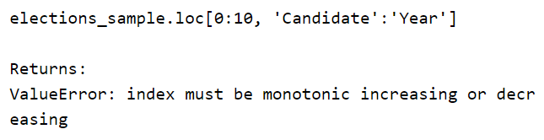
Indexing - .loc[]
You can access rows and columns of a DataFrame by name using the .loc[ ] syntax.
The syntax for .loc[ ] is:
df.loc[rows_list, column_list]
Range Slicing [0:10] works with .loc[] but only when the index is monotonic increasing or decreasing.
Will it work for elections_sample?

Slide 40

Indexing - .loc[]
You can access rows and columns of a DataFrame by name using the .loc[ ] syntax.
The syntax for .loc[ ] is:
df.loc[rows_list, column_list]
If you give .loc[] single scalar arguments for the requested rows and columns, you get back just a single value.

Slide 41
Indexing
There are many ways to access rows and columns of a Pandas DataFrame.
We will spend some time reviewing the most used options.
[]
.loc[]
Boolean Array Selection
.iloc[]

Slide 42

Indexing – Boolean Array Selection
[ ] and .loc[ ] support arrays of Booleans as an input.
In this case, the array must be exactly as long as the number of rows or columns.
The result is a filtered version of the DataFrame, where only rows corresponding to True appear.
This functionality is similar to WHERE in SQL.

Slide 43
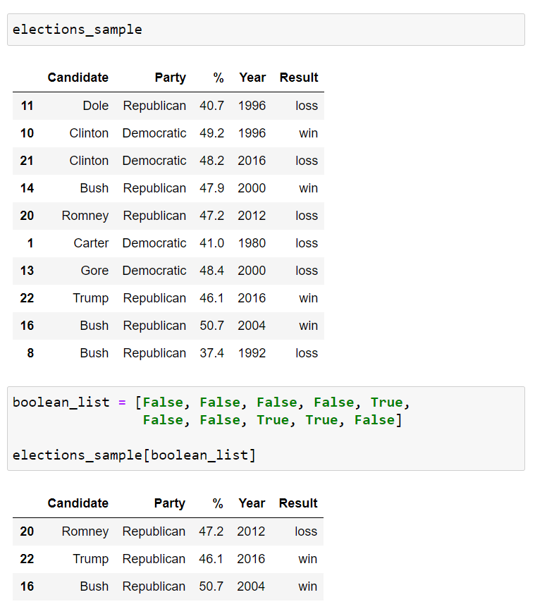
Indexing – Boolean Array Selection
[ ] and .loc[ ] support arrays of Booleans as an input.
In this case, the array must be exactly as long as the number of rows or columns.
The result is a filtered version of the DataFrame, where only rows corresponding to True appear.
This functionality is similar to WHERE in SQL.

Slide 44
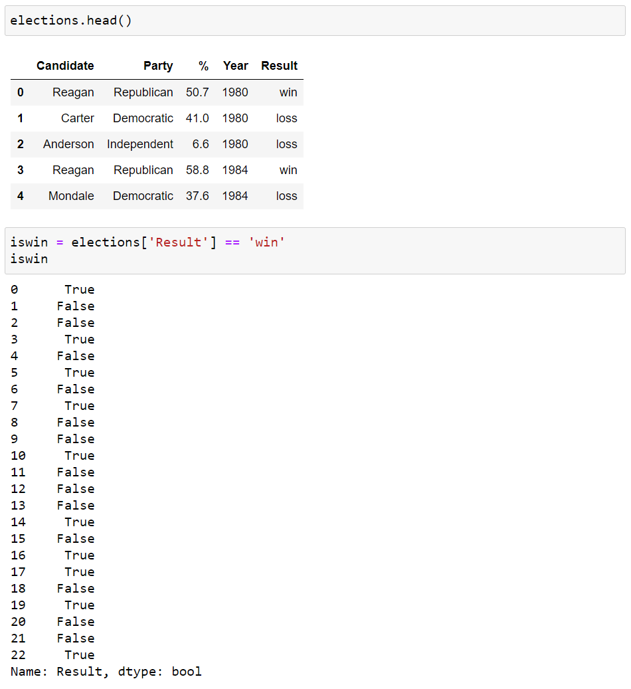
Indexing – Boolean Array Selection
One very common task in Data Science is filtering.
Boolean Array Selection is one way to achieve this in Pandas.
We start by observing logical operators like the equality operator == can be applied to Pandas Series data to generate a Boolean array.
For example, we can compare the Result column to the String ‘win’.

Slide 45
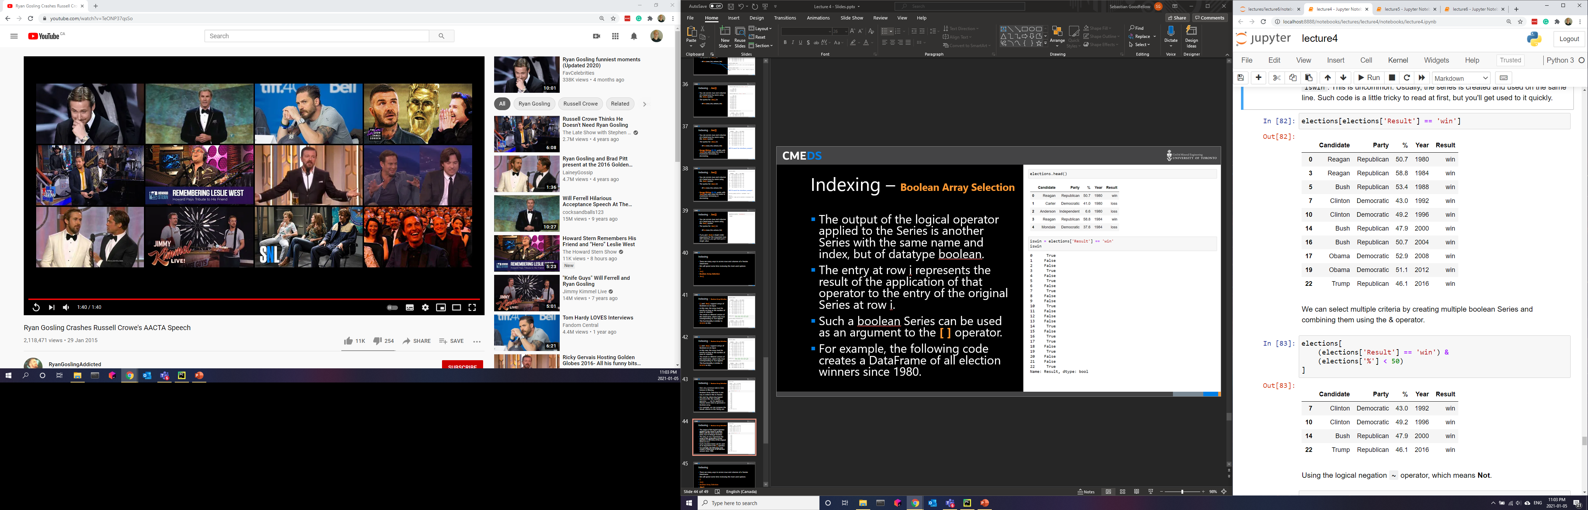
Indexing – Boolean Array Selection
The output of the logical operator applied to the Series is another Series with the same name and index, but of datatype Boolean.
The entry at row i represents the result of the application of that operator to the entry of the original Series at row i.
Such a Boolean Series can be used as an argument to the [ ] operator.

Slide 46
Indexing – Boolean Array Selection
We can select multiple criteria by creating multiple Boolean Series and combining them using the & operator.
Using the logical negation ~ operator, which means Not.
~(elections['%'] < 50)
You can also use the | operator, which mean Or.

Slide 47
Indexing
There are many ways to access rows and columns of a Pandas DataFrame.
We will spend some time reviewing the most used options.
[]
.loc[]
Boolean Array Selection
.iloc[]

Slide 48
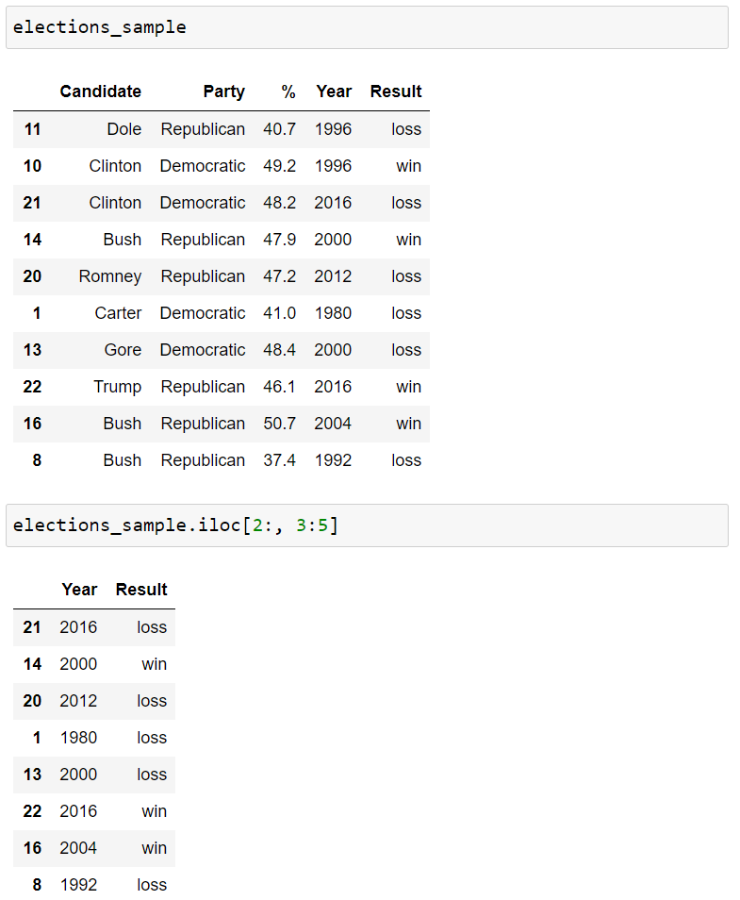
Indexing - .iloc()
0
1
2
3
4
0
1
.loc's cousin iloc is very similar, but is used to access based on numerical position instead of label.
For example, to access to the first 3 rows and first 3 columns of a table, we can use .iloc[0:3, 0:3].
.iloc slicing is exclusive, just like standard Python slicing of numerical values.
2
3
4
5
6
7
8
9

Slide 49
Indexing
We will use both .loc[] and .iloc[] in the course.
.loc[] is generally preferred for a number of reasons, for example:
It is harder to make mistakes since you have to literally write out what you want to get.
Code is easier to read, because the reader doesn't have to know e.g. what column #31 represents.
It is robust against permutations of the data, e.g. the database admit switches the order of two columns.

Slide 50
Pandas I
DataFrames
Pandas Data Structures
Importing Data
Indexing
Utility Methods

Slide 51
Utility Methods
Pandas has number of very useful helper methods.

Slide 52
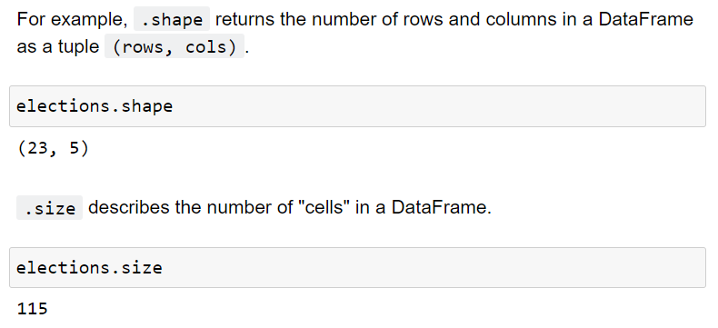
Utility Methods
.shape
.size

Slide 53
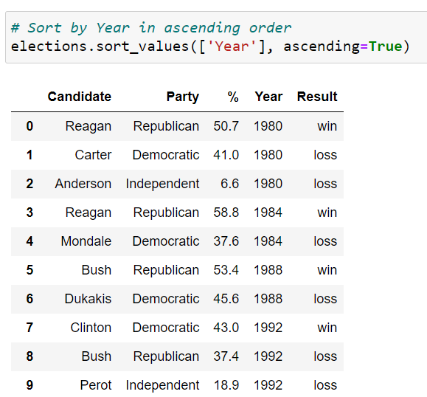
Utility Methods
.sort_values()

Slide 54
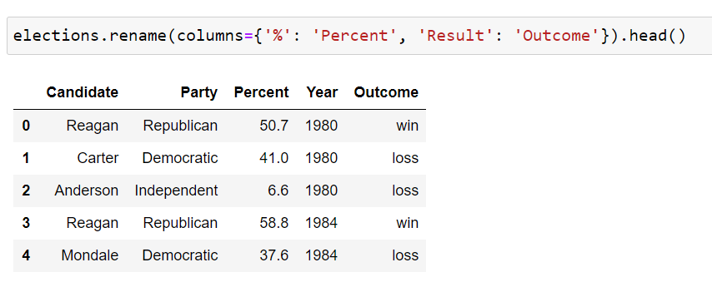
Utility Methods
.rename()

Slide 55
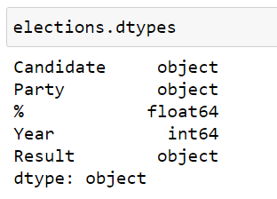
Utility Methods
.dtypes

Slide 56
Utility Methods
.describe()
.info()
.unique()
.value_count()
.astype()
Many, many, many more.

Slide 57
Practice!
Launch the Lecture 2.1 notebook from Quercus and review the material from this lecture in more detail.
Link

Slide 58
CME538 Introduction to Data Science
Week 2 | Lecture 1 (2.1)
Pandas I.

